Slide 1
Symptoms Detection Chatbot using Text Retrieval
By: Group 2

Slide 2
Problem Description
We are proposing a model algorithm to determine illness based on the user input.
User inputs a symptom or list of symptoms
The system responds with suggestions based on the input
Additionally, system will also respond with website to describe illness
Will also suggest nearby healthcare institutes

Slide 3
Motivation
Early Diagnosis
Search Engines provide vague/extreme information
System will specifically work for health purposes
Ensures concise or true to the case information

Slide 4
Key Challenges
So far chatbots have been designed to handle initial level requests
Language used by the user
Provide meaningful responses
Learn user intents/ Sentiment analysis
Fast response time
Testing for accuracy and methods that can be experimented with
Business Goals

Slide 5
Dataset Used
Two different datasets
Disease Description : https://www.kaggle.com/itachi9604/disease-symptom-description-dataset
Hospital dataset : https://hifld-geoplatform.opendata.arcgis.com/datasets/hospitals

Slide 6
Pre-processing Steps
Split symptoms into a comma separated value
Remove Stop words
Tokenization
Compute TF-IDF scores
Calculate Cosine similarity and Normalize the values
Read the CSV files
Tokenize disease dataset and provide output

Slide 7


Alternatives
Try Implementing Naïve Bayes
Implement using Tf-Idf

Slide 8
Related Work And Limitations
D.Y. Patil College of Engineering, et al. “A Medical ChatBot.” International Journal of Computer Trends and Technology, vol. 60, no. 1, June 2018, pp. 41–45. DOI.org (Crossref), doi:10.14445/22312803/IJCTT-V60P106. : Unable to implement a web based Api.
Qaiser, Shahzad, and Ramsha Ali. “Text Mining: Use of TF-IDF to Examine the Relevance of Words to Documents.” International Journal of Computer Applications, vol. 181, no. 1, July 2018, pp. 25–29. DOI.org (Crossref), doi:10.5120/ijca2018917395. : Algorithm cannot identify words in different tenses. Need to improve performance and accuracy.
Gupta, Manish, et al. “Implementation of Artificial Intelligence Based Chatbot System With Long Term Memory.” SSRN Electronic Journal, 2020. DOI.org (Crossref), doi:10.2139/ssrn.3574575. : Expensive chatbots

Slide 9
Architecture
Input User Data
Query Symptoms in the java
Suggest Symptoms
Compute query using TF-IDF
List the diseases
Provide disease description
Provide link to Wikipedia for more details
Suggest nearest hospital using zipcode

Slide 10
Validation
We are using the CSV datasets for our Java program to read
The application is able to correctly classify the symptoms and based on the user input
Tried implementing precision and recall.

Slide 11
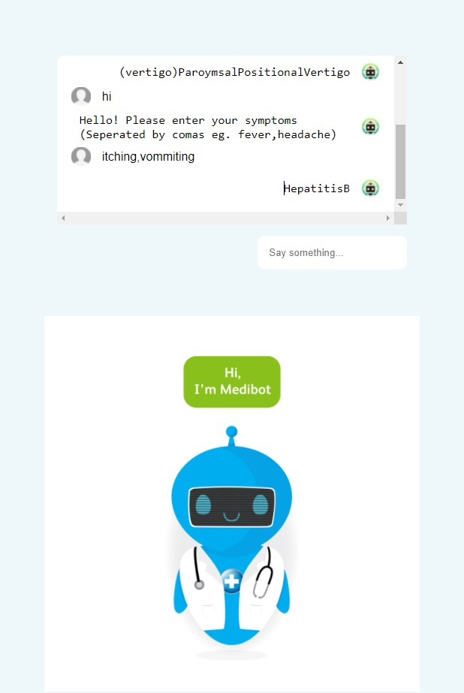
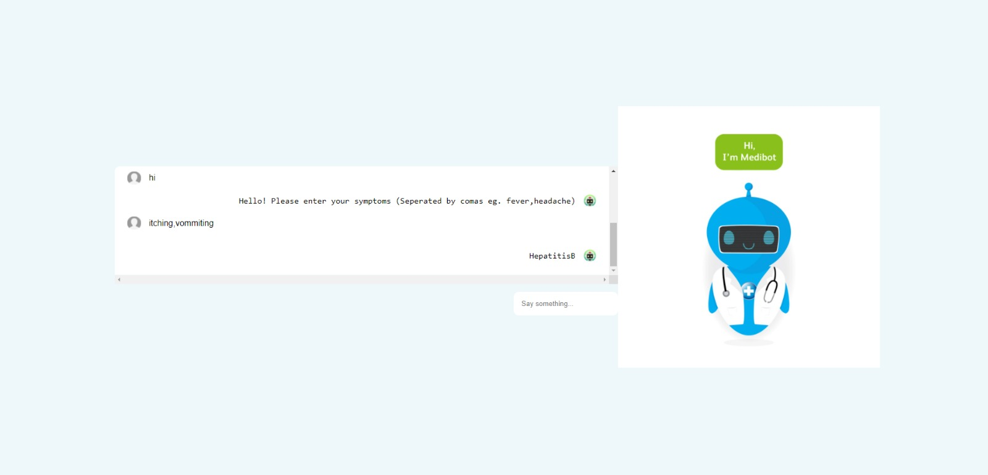
Results
Html Website

Slide 12
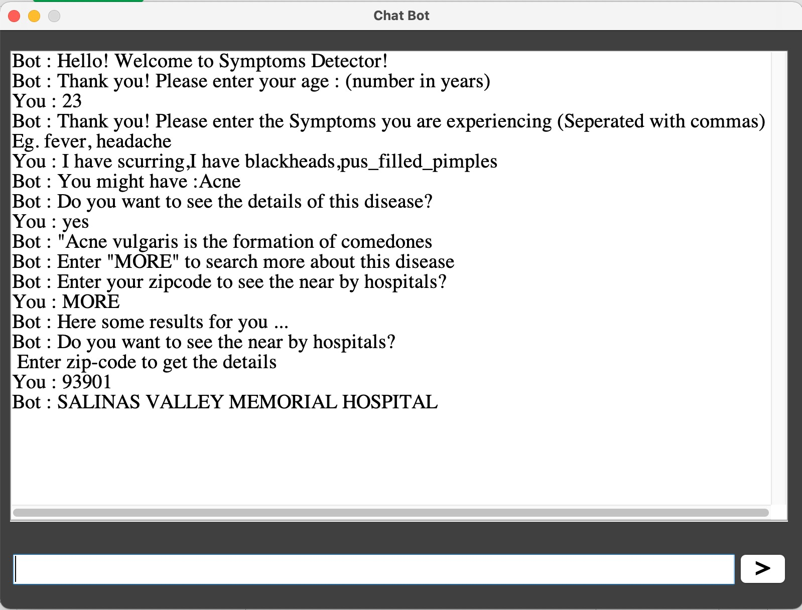
Results
Chatbot (Java GUI)

Slide 13
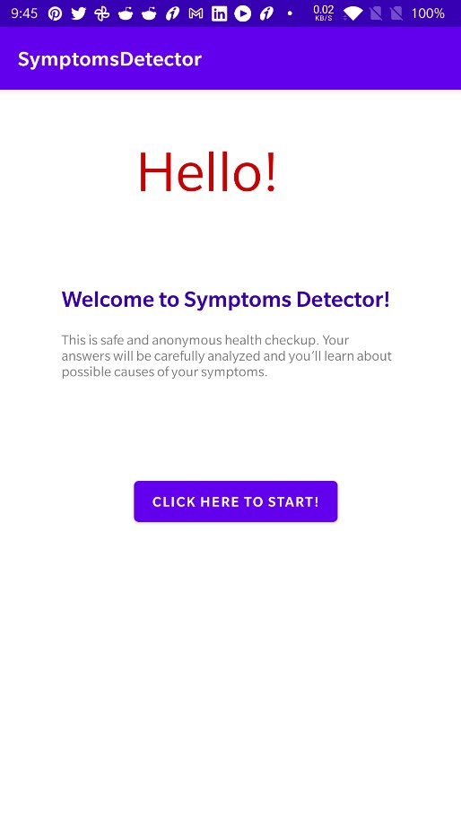
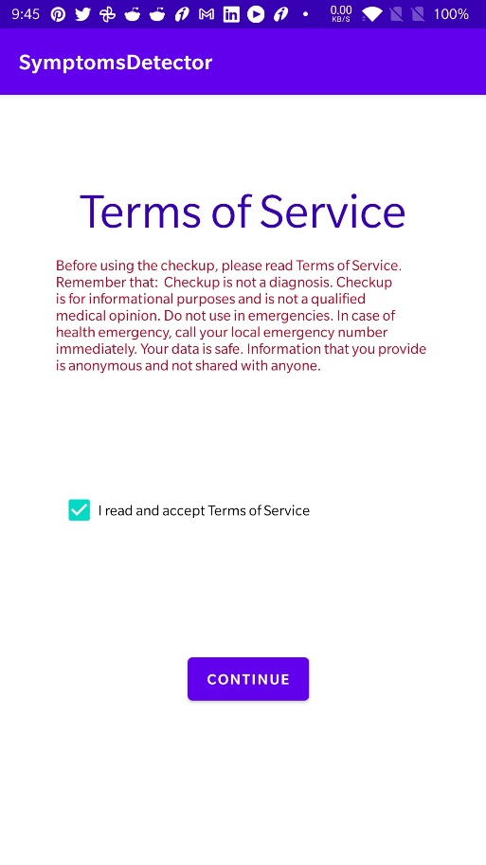
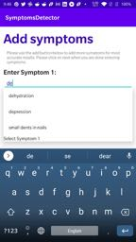
Results
Chatbot (Android application)

Slide 14

Conclusions
Higher performance standard
Reliable responses
No need to wait in wait queues for simple issues.
Can book an appointment with the nearest healthcare locations incase needed.

Slide 15
Future Work
Enable advanced precision and detail.
Execute bag-of-words.
Upgrade User experience.
Plan to implement Face recognition and deep user interaction

